Slide 1
Interviews

Slide 2
Informational Interview

Slide 3
Informational Interviews
They offer you an “inside look”
May serve as a source of constructive feedback about your resume.
When you seek someone, state that you are seeking career information and advice and when you would like to meet.
Request an in person interview.
Notes:
Meeting w/ a person in the career field that you would like to explore. A way to turn a passive job search into a proactive search campaign. Meeting should not exceed 30min. Ask if you can stay in contact with your interviwee

Slide 4
Informational Interview
Sample phone intro
Hello Ms. Her. My name is and I am a student at…I found your name through…I am exploring careers in your field and have some questions about the profession. Would it be possible to schedule a short meeting with you?
Sample Questions
How do you spend a typical day in your job?
2. How did you obtain this position? And what kind of degrees are needed?
3) What kinds of part-time jobs or internships do you think are helpful to entering this field?
4) What are the opportunities for advancement?
5) Can you suggest anyone else I may contact?
Interview
Dress and act professionally. Establish rapport and demonstrate interest in the interviewee’s comments. Request a business card at the end of the interview.
Follow-Up
Write a short thank you note within 24 hours after your interview. Keep the interview information on file for the future, this person may be an important contact for you later.

Slide 5
In-Person interview

Slide 6
In-Person Interview
Preparing for Interview
Do your research
Become familiar with the specifics and develop questions for the hiring committee.
Review your resume and cover letter
Familiarize yourself with the details about the interview
PRACTICE

Slide 7
Dress to Impress
Women | Men
Suit: Navy or dark two piece, professional skirted or pant suit. Length of skirt should be at knee or below Blouse: White or pastel silk blended button-down, long sleeve shirt. No sheer or low cut. Shoes: Dress shoe with a 1inch heel. Cosmetics: No perfume. Light makeup. Hair: Put up hair if you tend to play with your hair. | Suit: Navy or black two piece traditional cut suit. Shirt: Cotton long sleeve shirt. Tie: Conservative, stripes, paisley, or solid color. Shoes: Black and well polished. Cologne: No cologne or aftershave Jewelry: No earrings or visible piercings
Notes:
Although your unique style is important, the interview is not always the best time to demonstrate this via your wardrobe. Although your unique style is important, the interview is not always the best time to demonstrate this via your wardrobe.

Slide 8
Answering Interview Questions using the STAR method
S/T: The situation or the task that you were faced with.
A: Actions you took.
R: Results
Notes:
Interviewers often view past behavior as the as the best predictor of future behavior. , candidates can give information about how they will perform in the future by giving specific examples.
You can draw examples from academic projects, comm. Service, leadership roles, part-time work etc)

Slide 9
How you Speak
-Frequent uses of ah’s, um’s, and filler words (like, well, etc)
-Try using a pause
-Non verbal communication
-maintaining eye contact
-Habits (stroking hair,
-Firm handshake
-Smile
Notes:
A smile makes you exude confidence.
-handshake: ladies, limp handshake is not cute. And don’t break your future employers hand.

Slide 10
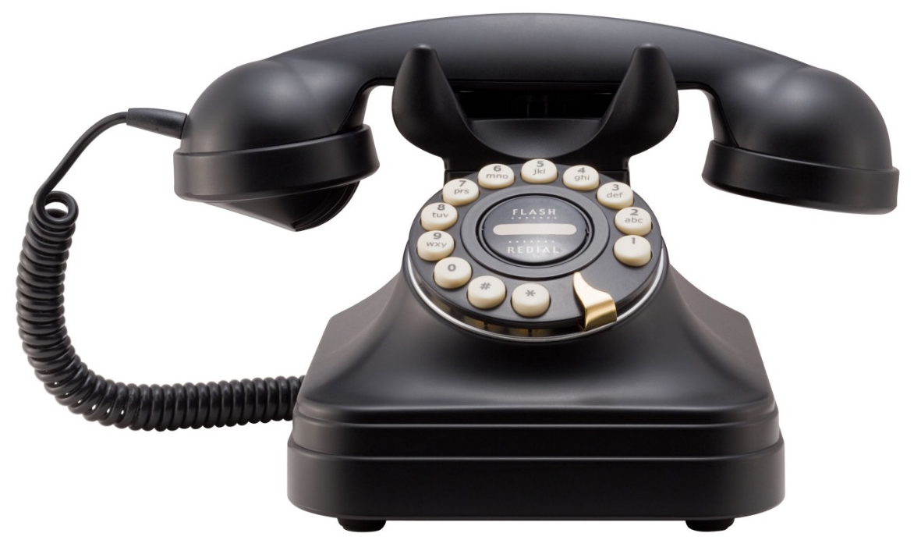
Telephone Interviewing
Notes:
-Many orgs use phone interviews.
-Why are phone interviews used?
-quick and inexpensive
-Sometimes is easier for the candidate.
-To followup w/ ?’s they neglected to ask in a previous interview.

Slide 11
Preparation
Prepare key points and come up with questions.
Make sure phone has excellent reception.
Record a professional-sounding voice mail.
If family members answer, remind them to take accurate messages.
Have access to a pen, notepad and resume and Cover letter.

Slide 12
The unexpected call
-Often you will have no advance warning before you receive a call.
-Keep handy a list of places where you have applied. You do not want to confuse yourself.
-Remember the names of the people interviewing you in order to ask questions directly to them.
Ignore call waiting
The scheduled phone interview
-Answer the phone “Hello, this is Erica”
-Immediately express your pleasure
-Do not chew gum, sip a drink or eat.
-A smile can be heard in your voice.
-Before ending call express your interest in working for them.
-After the call, make sure you send a thank you note

Slide 13
Questions
Common Interview Questions
Taylor your response
Do you have any questions?
Do not answer “NO”
Is the organization is a good fit for you?
During the 1st interview, do not ask about salary, benefits or vacation.
Notes:
-When answering a question, tailor your response so that it fits with the position.
-Do not ask ?s that were addressed during the interview.

Slide 14
Video Interview

Slide 15
Video Interviewing
-Camera should be at the same height as the top of your head.
-If you wear glasses, get an anti-glare coating.
-Use anti shine makeup
Look directly into the camera
-Manage the background
Notes:
-Having the camera in this position helps you maintain good posture.
-You want interviewees to get the feeling that they are making a connection with you (bc you are looking directly into the camera)
-shiny face can be read a nervous face. It can be distracting.

Slide 16
Now Let’s Practice!

